Slide 1
Otto von Bismarck and the Unification of Germany (1848-1871)
How did Otto Von Bismarck aid in the unification of Germany?

Slide 2
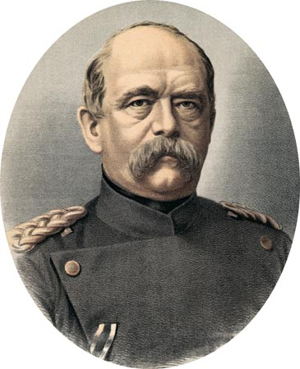
Otto Von Bismarck
The First Chancellor of Germany

Slide 3
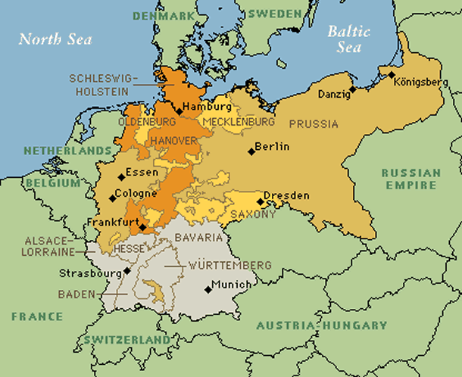
The German Nation States
ZOLLVEREIN: union of German states that reduced tariffs and encouraged trade

Slide 4
Chancellor Otto Von Bismarck
Analyze the following statement made by Chancellor Bismarck in regards to the future of Germany.
“Prussia must concentrate and maintain its power for the favorable moment which has already slipped by several times. Prussia's boundaries according to the Vienna treaties are not favorable to a healthy state life. The great questions of the time will not be resolved by speeches and majority decisions—that was the great mistake of 1848 and 1849—but by iron and blood.”

Slide 5
Blood!
What is Militarism?
“The belief or desire of a government or people that a country should maintain a strong military and be prepared to use it aggressively to defend or promote national interests “
How might Chancellor Bismarck achieve his goal of a unified Germany?

Slide 6
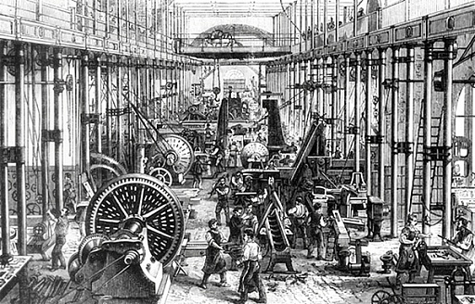
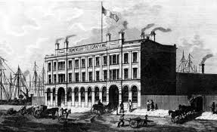
IRON!
“What needs to be made in order to allow Bismarck to fight the wars for unification? “

