Slide 1
Rivalries and Nationalistic Tension

Slide 2
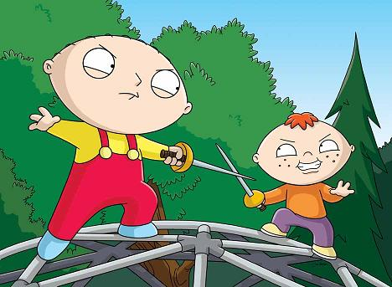
Think…
Do you have any personal rivalries? Or does Sachem East have a rival school? How does your, or your schools rivalry affect you?

Slide 3
Secret Alliances…
By 1914 most of Europe was divided into Two Armed Camps with millions of troops at the ready.
These two Alliances were created and planned in SECRET . These countries signed many deals And treaties , pledging to protect and defend each other.
History shows that these alliances were created out of the feeling of distrust and fear of rival nations. While these alliances were meant to be a way to preserve peace and stability in Europe, they would ultimately have the opposite effect.

Slide 4
The Rival Alliances
The Triple Alliance
Formed during Bismarck's reign.
Created as a way to ensure that France would not seek revenge over their loss in the Franco-Prussian War.
Germany, Italy, Austria-Hungary forge this alliance.
The Triple Entente
An agreement between nations to follow common policies.
Led to military and diplomatic ties.
Forged between Russia, Great Britain, and France.
Central Powers
Allied Powers

Slide 5
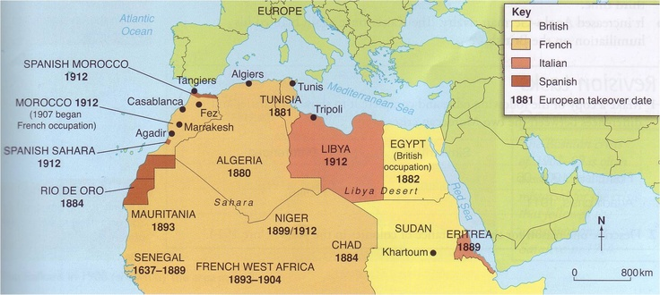
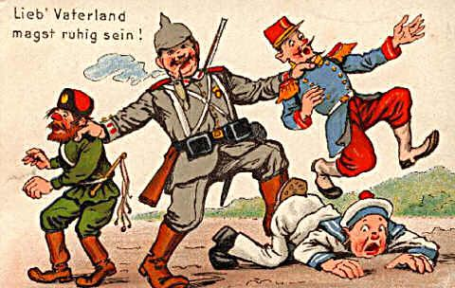
The Moroccan Crisis
Why is Morocco strategically important?
The Kaiser visits Morocco- 1905

Slide 6
What is an Arms Race?

Slide 7
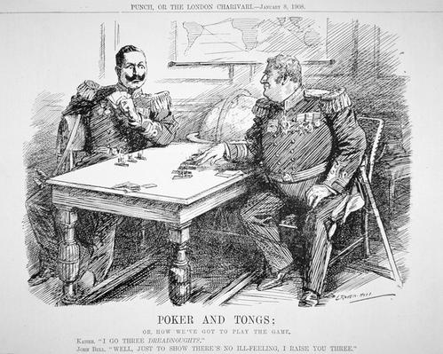
Germany and Britain Mobilize
“I go, Three Dreadnaughts!”- Kaiser Wilhelm II
“Well… Just to show there is no ill will, I’ll raise you three!” –British Prime Minister

