Slide 1
European Nationalism

Slide 2
To Be Specific…
Now that you have created your own definition of Nationalism, here is the official definition.
Nationalism is a strong feeling of pride in and devotion to ones Nation.
But what makes a nation?

Slide 3
What makes a Nation?
Culture
LANGUAGE
OR DIALECT
Nation
NATIONALITY
BELIEF IN COMMON
ANCESTORY
RELIGION
COMMON UNDERSTANDING OF History
TERRITORY

Slide 4
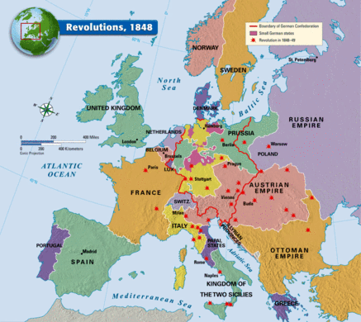
Where are the majority of these revolutions taking place? Why do you think wars are breaking out in these regions of Europe?

Slide 5
Germany and Italy | Ottoman Empire and Austria-Hungary
Populations are not diverse, share similar culture. States in Germany share a similar history dating back to the Napoleonic wars. States in Italy share a similar history. German states spoke a dialect of German. Common Language. Italian States spoke dialects of Italian. Common Language. Culture and traditions are common. What will these similarities lead to? Why? | Diversity Many different ethnic groups. (Turks, Kurds, Arabs, Greeks, Armenians, Hungarians, Austrians, various Slavik populations). Multiple religions: Islam, Christianity, Judaism. Why is diversity an issue? What did this lead to? Why?

